Slide 1
Documentation Building Blocks
Ted Habermann, John Kozimor
The HDF Group

Slide 2
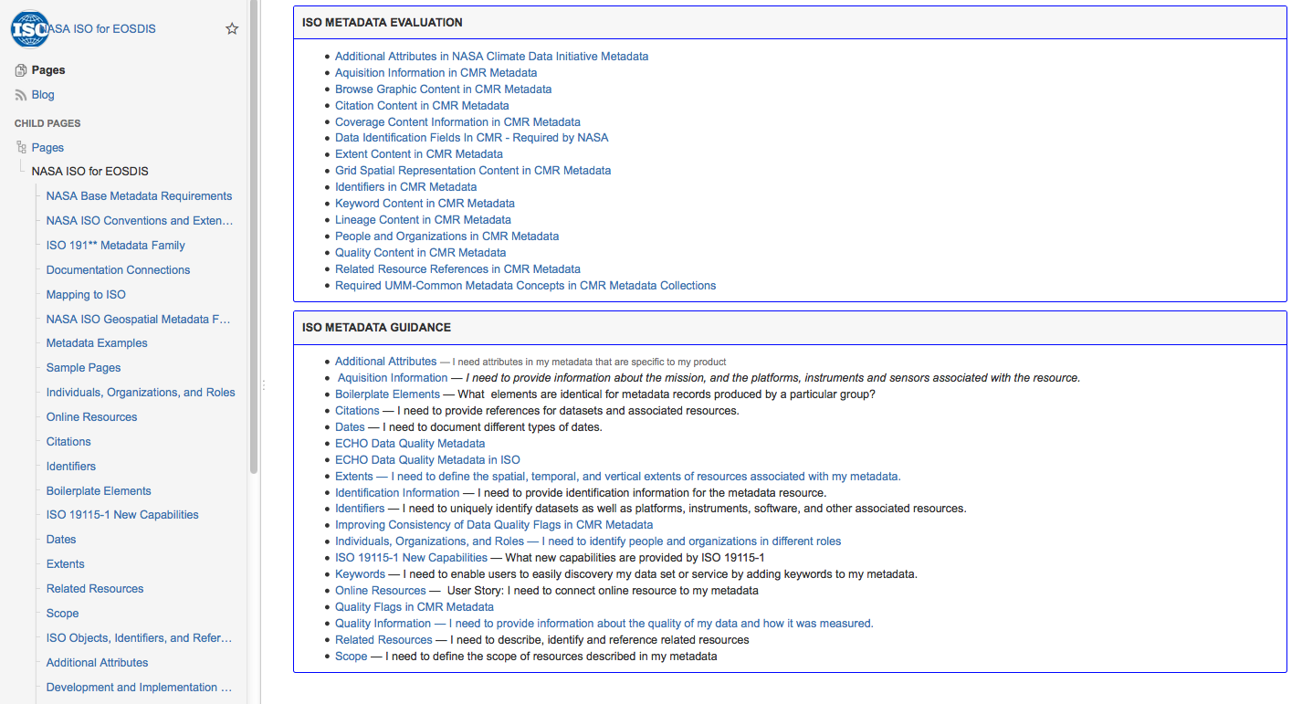

NASA Earth Data Wiki Guidance
<-- Wiki

Slide 3
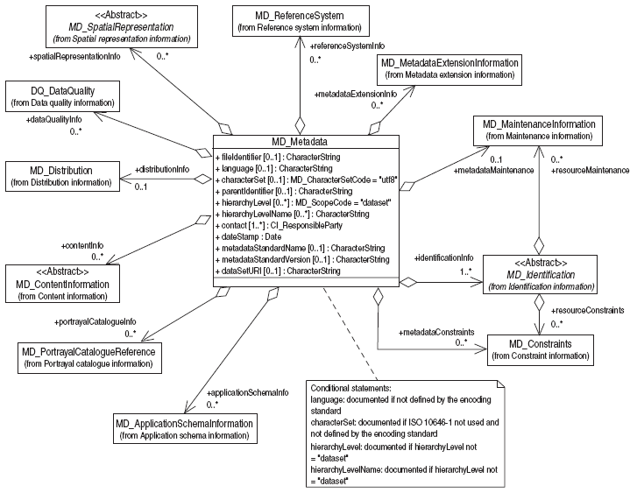
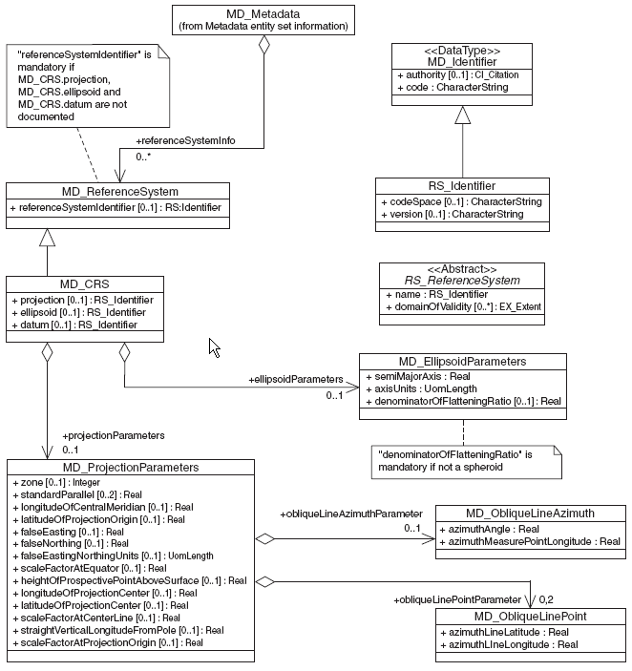
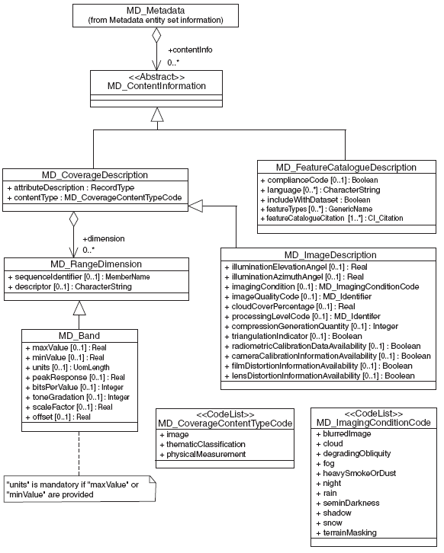
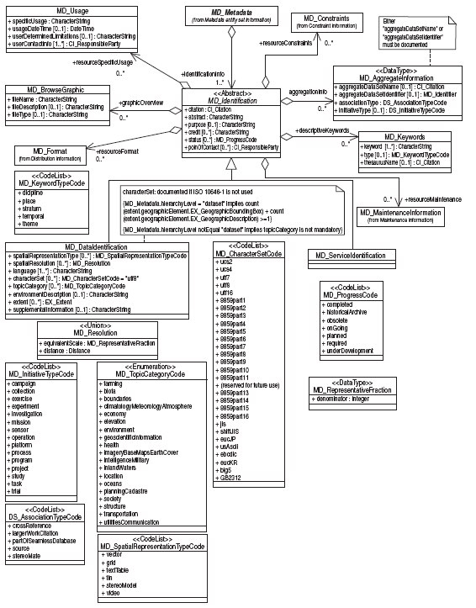
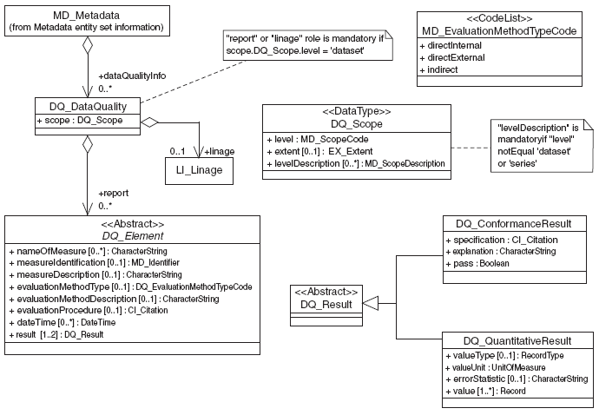
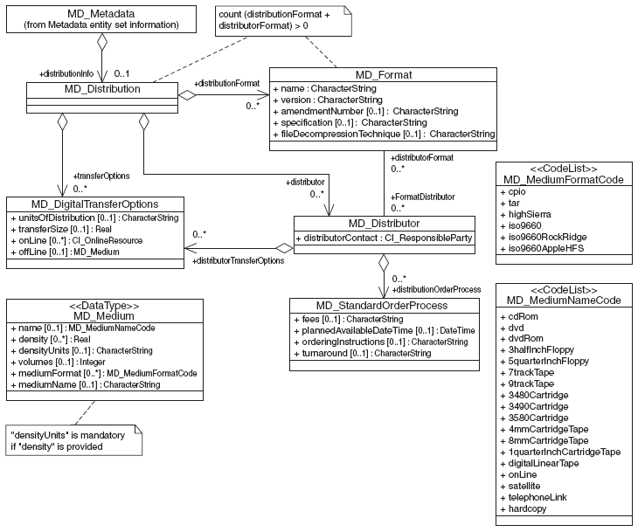
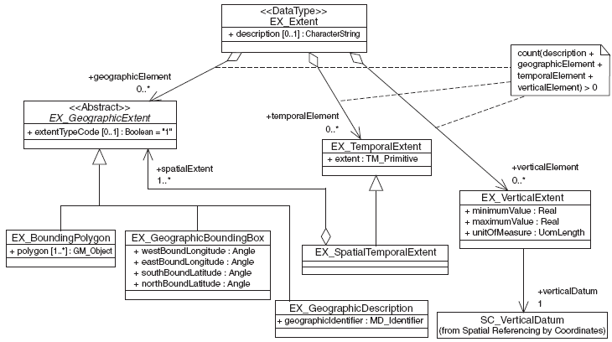
ISO UML - Every Picture Tells a Story
Training\ToolsAndSamples\UML\ISO_UML.pdf

Slide 4
ISO Building Blocks Workflow – Basic Elements
UML Introduction
XML Introduction
Tags
Elemants
Attributes
Namespaces
CodeLists
Locations
Values
MD_Identifier
Keywords
Types
Sources
Online Resource
UML Class Diagram
XML Workflow
Oxygen Menus
Associate Schema
Validate
Transform to html
CI_ResponsibleParty
Roles (Position or Tag)
Objects and References
CI_Citation
Parties
Identifiers
Links

Slide 5
ISO Building Blocks Workflow – Science Metadata
Extents
Temporal
Spatial
Identifiers
Dimensions
Lineage
Sources
Process Steps
Instruments
Scope
Code
Extent
Description
Variables
Groups / types
Fill Values
Data Quality
Coverage Reports

Slide 6
CI_OnlineResource
<<DataType>>
CI_OnlineResource
+ linkage : CharacterString
+ protocol : CharacterString [0..1]
+ applicationProfile : CharacterString [0..1] + name : CharacterString [0..1]
+ description : CharacterString [0..1]
+ function : CI_OnLineFunctionCode [0..1]
+ protocolRequest : CharacterString [0..1]
Notes:
Connecting metadata to resources on the web to web is critical to complete documentation. Including information to make those links useful is also important. The CI_OnlineResource Object is used in the ISO Standards to accomplish these tasks.
Structure
The structure of the CI_OnlineResource is shown here as UML (wiki) and described in the wiki. The only required field is linkage, the URL for the resource. There are five optional elements, each of which can occur just once, that provide more information about the resource that the URL links to. The function, name, and description can provide information to the user about what will happen when they click the link (see wiki for choices for the CI_OnlineFunctionCode). The function and protocol can be used to classify the link in several ways and the applicationProfile can be used to provide information about applications that might be able to use the link automatically.
wikiReference: https://geo-ide.noaa.gov/wiki/index.php?title=ISO_Online_Resources

Slide 7
UML.1
Type: package abbreviation_type
UML package abbreviation =
XML namespace = Document section
Attributes:
role [how many] : object type
Role: what this object does for me
contact: CI_ResponsibleParty
description: CharacterString
how many = [minimum..maximum]
minimum = 0: optional
minimum = 1: required
* = any number
how many = blank: required, one
how many = [1..*] : required, any number
how many = [1..2] : required, one or two
how many = [0..1] : optional, zero or one
how many = [0..*] : optional, any number
Type
Attributes
Operations
Operations: generally not used in ISO UML
Notes:
The Unified Modeling Language (UML), is a standardized general-purpose modeling language from the field of software engineering that is used to provide graphical representation of ISO and many other standards. Most of the ISO pictures are UML Class Diagrams that describe the structure of a metadata by showing the classes, their attributes, and the relationships between the classes. The key to understanding UML Diagrams is learning to "read" the diagrams into sentences that describe the objects and relationships being modeled.
This slide shows the three parts of a class diagram: the class type, attributes, and operations. The type is made up of a package abbreviation and a type. The attributes give roles, number of occurrences, and type. Operations are not generally used in ISO.
wikiReference: https://geo-ide.noaa.gov/wiki/index.php?title=Unified_Modeling_Language

Slide 8
UML.2
<<DataType>>
CI_OnlineResource
<<DataType>>
CI_OnlineResource =
the OnlineResource
is a DataType
in the Citation (CI) Package
+ linkage : URL
+ protocol [0..1] : CharacterString
+ applicationProfile [0..1] : CharacterString
+ name [0..1] : CharacterString
+ description [0..1] : CharacterString
+ function [0..1] : CI_OnLineFunctionCode
+ protocolRequest : CharacterString [0..1]
linkage : URL =
a CI_OnlineResource
must have
one linkage
which is a URL
protocol [0..1] : CharacterString = a CI_OnlineResource can have up to 1 which is a CharacterString
function [0..1] : CI_OnlineFunctionCode = a CI_OnlineResource can have up to 1 function which is a CI_OnlineFunctionCode
Notes:
Connecting metadata to resources on the web to web is critical to complete documentation. Including information to make those links useful is also important. The CI_OnlineResource Object is used in the ISO Standards to accomplish these tasks.
Structure
The structure of the CI_OnlineResource is shown here as UML (wiki) and described in the wiki. The only required field is linkage, the URL for the resource. There are five optional elements, each of which can occur just once, that provide more information about the resource that the URL links to. The function, name, and description can provide information to the user about what will happen when they click the link (see wiki for choices for the CI_OnlineFunctionCode). The function and protocol can be used to classify the link in several ways and the applicationProfile can be used to provide information about applications that might be able to use the link automatically.
wikiReference: https://geo-ide.noaa.gov/wiki/index.php?title=ISO_Online_Resources

Slide 9
XML Basics
Tag
A markup construct that begins with "<" and ends with ">”.
start-tags <section>
end-tags </section> and
empty-element <section/>
Element
A logical component of a document which either begins with a start-tag and ends with a matching end-tag, or consists only of an empty-element tag. Any characters between the start- and end-tags are the element's content, and may contain markup, including other elements, which are called child elements.
<Greeting>Content </Greeting>
Attribute
A markup construct consisting of a name/value pair within a start-tag or empty-element tag. In the example (below) the element step has one attribute, number with a value of “3”:
<step number="3">Connect A to B.</step>
Notes:
open empty CI_OnlineResource file here.

Slide 10
XML Namespaces
A term may exist in multiple contexts with different definitions. For example, the definition of the term court depends on the context. A namespace provides context and definitions for terms.
tennis:court is a place to play tennis
legal:court is a place for trials
Complete XML elements include an identifier for the namespace where they are defined:
<gmi:MI_Metadata> is the MI_Metadata element defined in the gmi namespace
<gmd:fileIdentifier> is the fileIdentifier element defined in the gmd namespace
<gco:CharacterString> is the fileIdentifier element defined in the gco namespace
Namespace locations must be listed in the first (root) element of each XML document:
xmlns:gmi=“http://www.isotc211.org/2005/gmi”
xmlns:gmd=“http://www.isotc211.org/2005/gmd”
xmlns:gco="http://www.isotc211.org/2005/gco"
Notes:
Find namespaces in your xml example…

Slide 11
CodeLists
<role>
<codeListName
codeList="Location#CodeListIdentifier"
codeListValue="CodeListValue">CodeListValue</codeListName>
</role>
<gmd:role>
<gmd:CI_RoleCode
codeList="http://www.isotc211.org/2005/resources/Codelist/
gmxCodelists.xml#CI_RoleCode"
codeListValue="processor">processor</gmd:CI_RoleCode>
</gmd:role>
<gmd:function>
<gmd:CI_OnLineFunctionCode
codeList="http://www.ngdc.noaa.gov/metadata/published/xsd/schema/
resources/Codelist/gmxCodelists.xml#gmd:CI_OnLineFunctionCode"
codeListValue="download">download</gmd:CI_OnLineFunctionCode>
</gmd:function>
Info
Notes:
This slide shows how codeLists are written in ISO-compliant XML. The first XML snippet shows where the various pieces are written. The second and third snippets are examples from CI_ResponsibleParty and CI_OnlineResource.
wikiReference: https://geo-ide.noaa.gov/wiki/index.php?title=ISO_19115_and_19115-2_CodeList_Dictionaries

Slide 12
CI_OnLineFunctionCode
<<CodeList>>
CI_OnLineFunctionCode
+ download + browseGraphic
+ information + upload
+ offlineAccess + emailService
+ order + browsing
+ search + fileAccess
+ completeMetadata
Notes:
The CI_OnlineFunctionCode codeList gives the possible functions for a CI_OnlineResource.
wikiReference:
https://geo-ide.noaa.gov/wiki/index.php?title=ISO_19115_and_19115-2_CodeList_Dictionaries

Slide 13
CI_RoleCode
<<CodeList>>
CI_RoleCode
+ resourceProvider + principalInvestigator + editor
+ custodian + processor + mediator
+ owner + publisher + rightsHolder
+ user + author + contributor
+ distributor + sponsor + funder
+ originator + coAuthor + stakeholder
+ pointOfContact + collaborator
Notes:
The CI_RoleCode codeList gives the possible roles for a CI_ResponsibleParty. Many of these roles can also be inferred from the position of the CI_responsibleParty in the standard. For example, an MD_DistributorContact usually has a role = distributor.
wikiReference: https://geo-ide.noaa.gov/wiki/index.php?title=ISO_People

Slide 14
CI_OnlineResource
<<DataType>>
CI_OnlineResource
+ linkage : URL
+ protocol [0..1] : CharacterString
+ applicationProfile [0..1] : CharacterString
+ name [0..1] : CharacterString
+ description [0..1] : CharacterString
+ function [0..1] : CI_OnLineFunctionCode
+ protocolRequest : CharacterString [0..1]
Notes:
Connecting metadata to resources on the web to web is critical to complete documentation. Including information to make those links useful is also important. The CI_OnlineResource Object is used in the ISO Standards to accomplish these tasks.
Structure
The structure of the CI_OnlineResource is shown here as UML (wiki) and described in the wiki. The only required field is linkage, the URL for the resource. There are five optional elements, each of which can occur just once, that provide more information about the resource that the URL links to. The function, name, and description can provide information to the user about what will happen when they click the link (see wiki for choices for the CI_OnlineFunctionCode). The function and protocol can be used to classify the link in several ways and the applicationProfile can be used to provide information about applications that might be able to use the link automatically.
wikiReference: https://geo-ide.noaa.gov/wiki/index.php?title=ISO_Online_Resources

Slide 15

Where Are CI_OnlineResources?
data distribution
contact information
XML
browse graphic
service connection points
citations
19115-1
metadata extensions

Slide 16
Where Are CI_OnlineResources?
<<DataType>>
CI_Contact
+ phone [0..1]: CI_Telephone
+ address [0..1]: CI_Address
+ onlineResource [0..1]: CI_OnlineResource
+ hoursOfService [0..1] : CharacterString
+ contactInstructions [0..1] : CharacterString
MD_DigitalTransferOptions
SV_OperationMetadata
+ unitsOfDistribution [0..1] : CharacterString
+ transferSize [0..1] : Real
+ onLine [0..*] : CI_OnlineResource
+ offLine [0..1] : MD_Medium
+ operationName : CharacterString
+ DCP [1..*] : DCPList
+ operationDescription [0..1] : CharacterString
+ invocationName [0..1] : CharacterString
+ connectPoint : [1..*] : CI_OnlineResource
MD_MetadataExtensionInformation
+ extensionOnLineResource [0..1]: CI_OnlineResource
Notes:
This slide shows the four objects in the ISO Standard that include CI_OnlineResources.
wikiReference: https://geo-ide.noaa.gov/wiki/index.php?title=Online_Resources

Slide 17
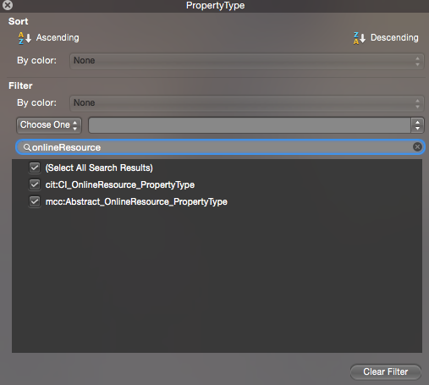
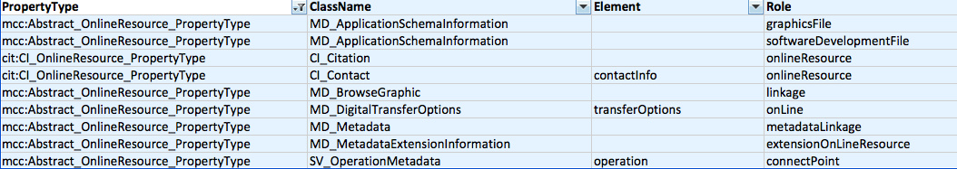
Where are OnlineResource objects in the ISO 19115-1 Metadata Model?
Find OnlineResource Objects:
Open findBBObjects.xlsx
Make PropertyType field active
Select the Filter button in the excel toolbar
Click down error in PropertyType field
Type onlineResource into the filter search box
See where OnlineResource object exists in the
ISO 19115-1 metadata model.
ISO Building Blocks Explorer

Slide 18
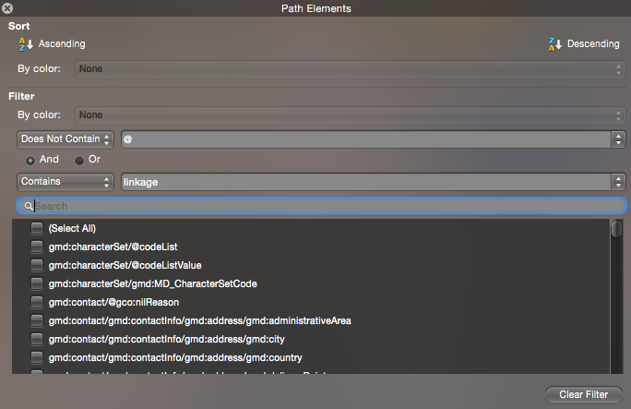
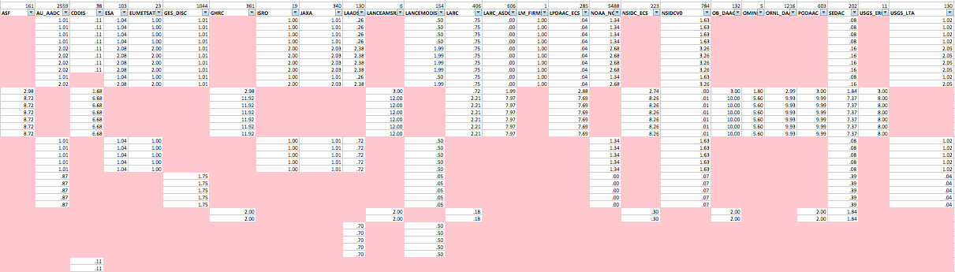
How are OnlineResource objects used in the Common Metadata Repository?
Identify OnlineResource Usage:
Open CMR-QuickEvaluation_2017.xlsx
Make Path Elements field active
Click the Filter button in the excel toolbar
Click down arrow in Path Element field
Select Not Contains = @
Select Contains = linkage
See where OnlineResource fields are used in
CMR metadata collections
CMR Quick Evaluation Report

Slide 19
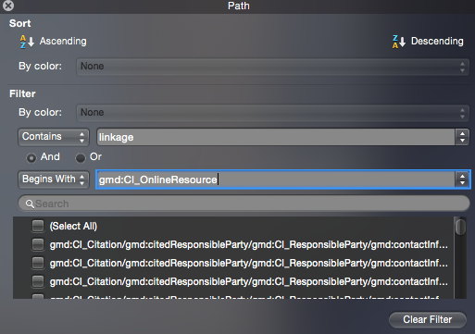
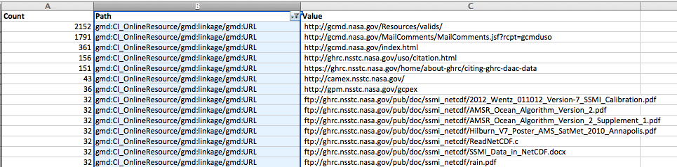
What is the content of OnlineResource objects in the Common Metadata Repository?
Identify OnlineResource Content:
Open reusableContent.xlsx
Make the Path field active
Click the Filter button in the excel toolbar
Click down arrow in Count field and sort descending
Select Contains = linkage
Select Begins With = CI_OnlineResource
See content in OnlineResource Objects
Reusable Content Report

Slide 20
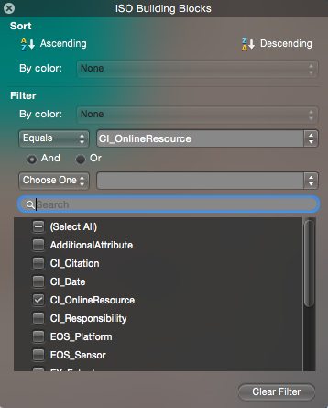
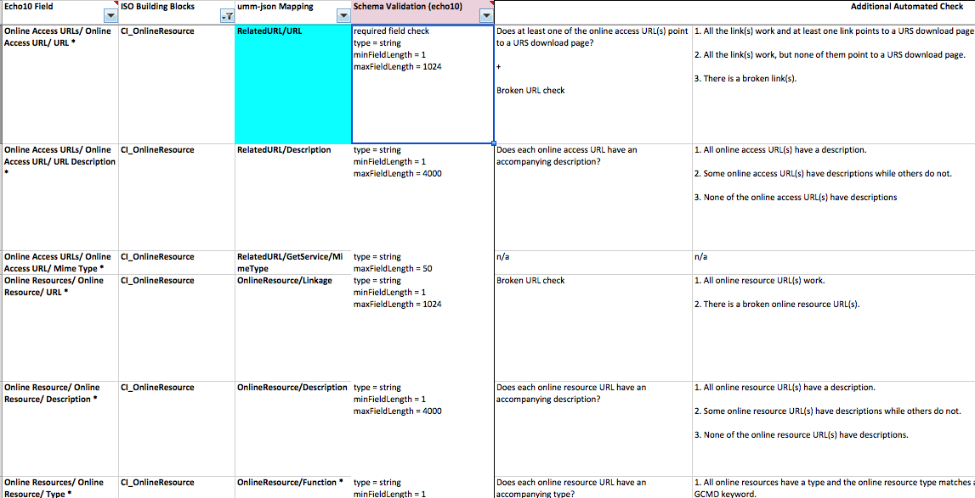
What are the ARC Curation rules for OnlineResource fields in the Common Metadata Repository?
Identify OnlineResource Curation Rules:
Open echoCurationRules.xlsx
Select row 3 (Title Fields)
Click the Filter button in the excel toolbar
Click down arrow in ISO Buiding Blocks field
Select CI_OnlineResource Building Block check box.
View CI_OnlineResource Curation rules in the spreadsheet
OnlineResource Curation Rules

Slide 21
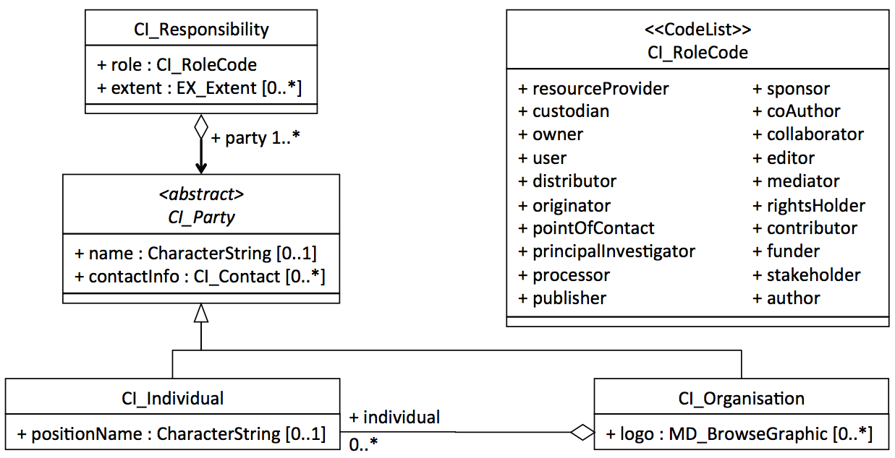
CI_Responsibility - UML
Notes:
The ISO standard offers a new and very powerful approach for attaching organizations and people to metadata records. The CI_ResponsibleParty object describes people and organizations that are related to a resource and their roles. It is used throughout the ISO Standards to describe and provide contact information for people and organizations.
The simple UML for the object is shown here. It includes one required element and four optional elements each of which can occur once. The CI_Contact includes information about physical and electronic addresses as well as a CI_OnlineResource as part of the contact information.
ISO Citations can include any number of organizations or people (citedResponsibleParties), each with one of the following roles: resourceProvider, custodian, owner, user, distributor, originator, pointOfContact, principalInvestigator, processor, publisher, or author. For example, the principle citation for a metadata record, in the MD_Identification section, can include an author, a publisher, and any number of principal investigators. This is very different than the FGDC approach, where the idinfo section has a citation that can include, but not differentiate roles for, many originators and a single point of contact with no clear role definition.
wikiReference: https://geo-ide.noaa.gov/wiki/index.php?title=ISO_People

Slide 22
CI_ResponsibleParty - UML
<<DataType>>
CI_ResponsibleParty
+ individualName [0..1]: CharacterString
+ organisationName [0..1]: CharacterString
+ positionName [0..1]: CharacterString
+ contactInfo [0..1]: CI_Contact
+ role: CI_RoleCode
Notes:
The ISO standard offers a new and very powerful approach for attaching organizations and people to metadata records. The CI_ResponsibleParty object describes people and organizations that are related to a resource and their roles. It is used throughout the ISO Standards to describe and provide contact information for people and organizations.
The simple UML for the object is shown here. It includes one required element and four optional elements each of which can occur once. The CI_Contact includes information about physical and electronic addresses as well as a CI_OnlineResource as part of the contact information.
ISO Citations can include any number of organizations or people (citedResponsibleParties), each with one of the following roles: resourceProvider, custodian, owner, user, distributor, originator, pointOfContact, principalInvestigator, processor, publisher, or author. For example, the principle citation for a metadata record, in the MD_Identification section, can include an author, a publisher, and any number of principal investigators. This is very different than the FGDC approach, where the idinfo section has a citation that can include, but not differentiate roles for, many originators and a single point of contact with no clear role definition.
wikiReference: https://geo-ide.noaa.gov/wiki/index.php?title=ISO_People

Slide 23
Where Are People?
science
contact
processor
originator
XML
resource
maintenance
user
metadata
maintenance
metadata
contact
metadata
extender

Slide 24
Explore Metadata
Where are Responsibility objects in the standard?
1) Open findBBObjects.xlsx
2) Make PropertyType field Active
3) Click the Filter button
4) Click the dropdown arrow to access worksheet filter
5) Type responsibility into the search box
6) Identify ISO Classes that include Responsibility
How are Responsibility objects used in the CMR?
1) Open CMR-QuickEvaluation_2017.xlsx
2) Make Path Elements field Active
3) Click the Filter button
4) Click the dropdown arrow to access worksheet filter
5) Select does not contain = @
6) Select contains = role
What content is in the Responsibility object?
1) Open reusableContent.xlsx
2) Make Path field active
3) Click Filter button
4) Select Begins With = gmd:CI_ResponsibleParty
5) Select Contains = gmd:organisationName
Notes:
The ISO standard offers a new and very powerful approach for attaching organizations and people to metadata records. The CI_ResponsibleParty object describes people and organizations that are related to a resource and their roles. It is used throughout the ISO Standards to describe and provide contact information for people and organizations.
The simple UML for the object is shown here. It includes one required element and four optional elements each of which can occur once. The CI_Contact includes information about physical and electronic addresses as well as a CI_OnlineResource as part of the contact information.
ISO Citations can include any number of organizations or people (citedResponsibleParties), each with one of the following roles: resourceProvider, custodian, owner, user, distributor, originator, pointOfContact, principalInvestigator, processor, publisher, or author. For example, the principle citation for a metadata record, in the MD_Identification section, can include an author, a publisher, and any number of principal investigators. This is very different than the FGDC approach, where the idinfo section has a citation that can include, but not differentiate roles for, many originators and a single point of contact with no clear role definition.
wikiReference: https://geo-ide.noaa.gov/wiki/index.php?title=ISO_People

Slide 25
Where Are People?
MI_Metadata
+ fileIdentifier [0..1] : CharacterString
+ language [0..1] : CharacterString
+ characterSet [0..1] : MD_CharacterSetCode = "utf8"
+ parentIdentifier [0..1] : CharacterString
+ hierarchyLevel [0..*] : MD_ScopeCode = "dataset"
+ hierarchyLevelName [0..*] : CharacterString
+ contact [1..*] : CI_ResponsibleParty
+ dateStamp : Date
+ metadataStandardName [0..1] : CharacterString
+ metadataStandardVersion [0..1] : CharacterString
+ dataSetURI [0..1] : CharacterString
+ locale [0..*] : PT_Locale
Notes:
Where are people in the ISO Standards?
This slide shows the contact that is included in the MD or MI_Metadata object. This is the metadata contact. The first ten attributes of this object, above dataSetURi in this diagram, describe characteristics of the metadata record.
wikiReference: https://geo-ide.noaa.gov/wiki/index.php?title=ISO_19115_Metadata_Entity_Information

Slide 26
Where Are People?
<<Abstract>>
MD_Identification
+ citation : CI_Citation
+ abstract : CharacterString
+ purpose [0..1] : CharacterString
+ credit [0..*] : CharacterString
+ status [0..*] : MD_ProgressCode
+ pointOfContact [0..*] : CI_ResponsibleParty
Notes:
Where are people in the ISO Standards?
This slide shows the metadata contact that is included in the MD_Identification object. The MD_Identification Object is an Abstract Object that holds general identification information. It is required and there can be any number of these objects in an MD_Metadata container. At present the MD_Identification Object can be instantiated either as a MD_DataIdentification Object, for datasets, or a MD_ServiceIdentification Object, for services.
wikiReference: https://geo-ide.noaa.gov/wiki/index.php?title=ISO_19115_Identification_Information

Slide 27
Where Are People?
<<DataType>>
CI_Citation
+ title : CharacterString
+ alternateTitle [0..*] : CharacterString
+ date [1..*] : CI_Date
+ edition [0..1] : CharacterString
+ editionDate [0..1] : Date
+ identifier [0..*] : MD_Identifier
+ citedResponsibleParty [0..*] : CI_ResponsibleParty
+ presentationForm [0..*] : CI_PresentationFormCode
+ series [0..1] : CI_Series
+ otherCitationDetails [0..1] : CharacterString
+ collectiveTitle [0..1] : CharacterString
+ ISBN [0..1] : CharacterString
+ ISSN [0..1] : CharacterString
Notes:
Where are people in the ISO Standards?
This slide shows the citedResponsibleParty that is included in the CI_Citation object. This CI_ResponsibleParty describes people or organizations associated with the resource being cited. These contacts typically have roles like author, originator, principleInvestigator.
wikiReference: https://geo-ide.noaa.gov/wiki/index.php?title=ISO_Citations

Slide 28
Where Are People?
MD_Usage
+ specificUsage : CharacterString
+ usageDateTime [0..1] : DateTime
+ userDeterminedLimitations [0..1] : CharacterString
+ userContactInfo [1..*] : CI_ResponsibleParty
Notes:
Where are people in the ISO Standards?
This slide shows the citedResponsibleParty that is included in the MD_Usage object. This CI_ResponsibleParty describes people or organizations that have used the resource.
wikiReference:

Slide 29
Where Are People?
LE_ProcessStep
+ description : CharacterString
+ rationale [0..1] : CharacterString
+ dateTime [0..1] : DateTime
+ processor [0..*] : CI_ResponsibleParty
Notes:
Where are people in the ISO Standards?
This slide shows the processor that is included in the LI_ or LE_ProcessStep object. This CI_ResponsibleParty describes people or organizations that process the data. These contacts typically have the processor role.
wikiReference: https://geo-ide.noaa.gov/wiki/index.php?title=ISO_Lineage

Slide 30
Where Are People?
MD_ExtendedElementInformation
+ name : CharacterString
+ shortName [0..1] : CharacterString
+ domainCode [0..1] : Integer
+ definition : CharacterString
+ obligation [0..1] : MD_ObligationCode
+ condition [0..1] : CharacterString
+ dataType : MD_DatatypeCode
+ maximumOccurence [0..1] : CharacterString
+ domainValue [0..1] : CharacterString
+ parentEntity [1..*] : CharacterString
+ rule : CharacterString
+ rationale [0..*] : CharacterString
+ source [1..*] : CI_ResponsibleParty
Notes:
Where are people in the ISO Standards?
This slide shows the processor that is included in the MD_ExtensionElementInformation object. This CI_ResponsibleParty describes people or organizations that are responsible for creating extensions to the metadata model. These contacts typically have the pointOfContact role.
wikiReference: https://geo-ide.noaa.gov/wiki/index.php?title=ISO_Extensions

Slide 31
Where Are People?
MD_Distributor
+ distributorContact : CI_ResponsibleParty
+ distributorFormat [0..*] : MD_Format
+ distributorTransferOptions [0..*] : MD_DigitalTransferOptions
Notes:
Where are people in the ISO Standards?
This slide shows the processor that is included in the MD_Distributor object. This CI_ResponsibleParty describes people or organizations that are responsible for distributing data or resources. These contacts typically have the distributor role.
wikiReference: https://geo-ide.noaa.gov/wiki/index.php?title=ISO_Distribution_Information

Slide 32
Where Are People?
MD_MaintenanceInformation
+ maintenanceAndUpdateFrequency : MD_MaintenanceFrequencyCode
+ dateOfNextUpdate [0..1] : Date
+ userDefinedMaintenanceFrequency [0..1] : TM_PeriodDuration
+ updateScope [0..*] : MD_ScopeCode
+ updateScopeDescription [0..*] : MD_ScopeDescription
+ maintenanceNote [0..*] : CharacterString
+ contact [0..*] : CI_ResponsibleParty
Notes:
Where are people in the ISO Standards?
This slide shows the processor that is included in the MD_MaintenanceInformation object. This CI_ResponsibleParty describes people or organizations that are responsible for maintaining resources or metadata. These contacts typically have the custodian role.
wikiReference: https://geo-ide.noaa.gov/wiki/index.php?title=ISO_19115_Metadata_Maintenance

Slide 33
Database and XML Keys
XML
<person id=JaneDoe>
<friend xlink:href="#JohnDoe"/>
</person>
Citation
ID
Title
Date
Friend_ID
Location_ID
…
…
…
…
<person id=JohnDoe>
<friend xlink:href="#JaneDoe"/>
</person>
Person
ID
Name
EMail
OnlineResource
ID
Name
URL

Slide 34
XML Attributes: Objects and References
ISO XML consists of tags, elements (with or without content), and attributes. An attribute is a name/value pair that exists within a start-tag or empty-element tag. Attributes provide additional information about an element which is not part of the data. Attribute values must contain either single or double quotes. This example shows a step element with one attribute, number with a value of “3”:
<step number="3">Connect A to B.</step>
Many of the XML attributes used in the ISO Standards fall into two groups: identifiers and references:
Identifiers: id and uuid
References: uuidref and xlink:href
role: friend xlink:href=#JohnDoe
object:
CI_ResponsibleParty
id="JaneDoe"
Objects start with upper case letters have identifiers (id and uuid)
Roles start with lower case letters have references (uuidref and xlink:href)
role: friend xlink:href=#JaneDoe
object:
CI_ResponsibleParty
id="JohnDoe"
Notes:
Many of the XML attributes used in the ISO Standards fall into two groups: identifiers and references. The identifiers id and uuid are used to identify objects. They can generally be used with any ISO object (elements that start with two capital letters like MD_, CI_, or EX_). References are used with roles (elements with camelCase names that start with lowercase letters) to refer to the objects that fill those roles.
wikiReference: https://geo-ide.noaa.gov/wiki/index.php?title=ISO_XML_Attributes

Slide 35
CI_Citation
<<DataType>>
CI_Citation
+ title : CharacterString
+ alternateTitle [0..*] : CharacterString
+ date [1..*] : CI_Date
+ edition [0..1] : CharacterString
+ editionDate [0..1] : Date
+ identifier [0..*] : MD_Identifier
+ presentationForm [0..*] : CI_PresentationFormCode
+ series [0..1] : CI_Series
+ otherCitationDetails [0..1] : CharacterString
+ collectiveTitle [0..1] : CharacterString
+ ISBN [0..1] : CharacterString
+ ISSN [0..1] : CharacterString
+ onlineResource [0..*] : CI_OnlineResource
+ graphic [0..*] : MD_BrowseGraphic
Notes:
Citations are used to provide information about citing the resource being described in the metadata or to refer to resources outside of the metadata record.
Structure
CI_Citation Object
The CI_Citation includes two required and eleven optional elements and introduces several new objects. The CI_Series object gives the name, issue, and page numbers of an article in a periodical. The ISBN and ISSN elements are internationally recognized identifiers for books and periodicals.
wikiReference: https://geo-ide.noaa.gov/wiki/index.php?title=ISO_Citations

Slide 36
Where Are Citations?
dataset /
resource
source
application
schema
keyword
thesaurus
& ontology
algorithm
feature
catalog
standard
specification
XML
evaluation
procedure
format
specification
feature
catalog
constraints
reference
additional
documentation
metadata
& service
standard
source
metadata
process
reference &
documentation
software
reference
alternate
metadata
associated
resource
name/metadata

Slide 37
Explore Metadata
Where are Citation in the standard?
1) Open findBBObjects.xlsx
2) Make PropertyType field Active
3) Click the Filter button
4) Click the dropdown arrow to access worksheet filter
5) Type citation into the search box
6) Identify ISO Classes that include Responsibility
How are Citations used in the CMR?
1) Open CMR-QuickEvaluation_2017.xlsx
2) Make Path Elements field Active
3) Click the Filter button
4) Click the dropdown arrow to access worksheet filter
5) Select does not contain = @
6) Select contains = gmd:title
What content is in Citations?
1) Open reusableContent.xlsx
2) Make Path field active
3) Click Filter button
4) select Begins With = gmd:CI_Citation
5) select Contains = gmd:title
Notes:
The ISO standard offers a new and very powerful approach for attaching organizations and people to metadata records. The CI_ResponsibleParty object describes people and organizations that are related to a resource and their roles. It is used throughout the ISO Standards to describe and provide contact information for people and organizations.
The simple UML for the object is shown here. It includes one required element and four optional elements each of which can occur once. The CI_Contact includes information about physical and electronic addresses as well as a CI_OnlineResource as part of the contact information.
ISO Citations can include any number of organizations or people (citedResponsibleParties), each with one of the following roles: resourceProvider, custodian, owner, user, distributor, originator, pointOfContact, principalInvestigator, processor, publisher, or author. For example, the principle citation for a metadata record, in the MD_Identification section, can include an author, a publisher, and any number of principal investigators. This is very different than the FGDC approach, where the idinfo section has a citation that can include, but not differentiate roles for, many originators and a single point of contact with no clear role definition.
wikiReference: https://geo-ide.noaa.gov/wiki/index.php?title=ISO_People

Slide 38
Where Are Citations?
<<Abstract>>
MD_Identification
+ citation : CI_Citation
+ abstract : CharacterString
+ purpose [0..1] : CharacterString
+ credit [0..*] : CharacterString
+ status [0..*] : MD_ProgressCode
+ pointOfContact [0..*] : CI_ResponsibleParty
Notes:
Where are citations in the ISO Standards?
The Resource Citation is an important part of the MD_Identification object. It includes descriptions of the people involved in the creation of the resource and other information that should be used when citing the resource that is being described by the metadata record.
The MD_Identification object is abstract object that can be instantiated for data and other resources:
/gmi:MI_Metadata/gmd:identificationInfo/gmd:MD_DataIdentification/gmd:citation
or for services
/gmi:MI_Metadata/gmd:identificationInfo/srv:ServiceIdentification/gmd:citation
wikiReference: https://geo-ide.noaa.gov/wiki/index.php?title=ISO_19115_Identification_Information
https://geo-ide.noaa.gov/wiki/index.php?title=Unified_Modeling_Language#Abstract_Classes

Slide 39
Where Are Citations?
LE_Source
+ description [0..1] : CharacterString
+ scaleDenominator [0..1] : MD_RepresentativeFraction
+ sourceReferenceSystem [0..1] : MD_ReferenceSystem
+ sourceCitation [0..1] : CI_Citation
+ sourceExtent [0..*] : EX_Extent
+ processedLevel[0..1] : MD_Identifier
+ resolution [0..1] : LE_NominalResolution
+ sourceStep [0..*] : LE_ProcessStep
Notes:
Where are citations in the ISO Standards?
Many datasets are constructed by combining or processing various sources. These sources are described in the LI_ or LE_Source object (LE_Source was added in ISO 19115-2).
wikiReference: https://geo-ide.noaa.gov/wiki/index.php?title=ISO_Lineage

Slide 40
Where Are Citations?
<<Abstract>>
DQ_Element
+ nameOfMeasure [0..*] : CharacterString
+ measureIdentification [0..1] : MD_Identifier
+ measureDescription [0..1] : CharacterString
+ evaluationMethodType [0..1] : DQ_EvaluationMethodTypeCode
+ evaluationMethodDescription [0..1] : CharacterString
+ evaluationProcedure [0..1] : CI_Citation
+ dateTime [0..*] : DateTime
+ result [1..2] : DQ_Result
Notes:
Where are citations in the ISO Standards?
The ISO quality evaluationProceedure is used to describe how a particular quality measure has been applied to a dataset or resource. It is cited using the DQ_Element/evaluationProcedure citation.
wikiReference: https://geo-ide.noaa.gov/wiki/index.php?title=ISO_Lineage

Slide 41
Where Are Citations?
MD_Keywords
+ keyword [1..*] : CharacterString
+ type [0..1] : MD_KeywordTypeCode
+ thesaurusName [0..1] : CI_Citation
Notes:
Where are citations in the ISO Standards?
The thesaurusName is used to cite the source for keywords in the MD_Keywords object.
wikiReference: https://geo-ide.noaa.gov/wiki/index.php?title=ISO_Components

Slide 42
Where Are Citations?
LE_Algorithm
+ citation: CI_Citation
+ description : CharacterString
Notes:
Where are citations in the ISO Standards?
The LE_Algorithm/citation is used to cite algorithms used in the processing of a resource. It is part of the extended lineage (LE) model added as part of ISO 19115-2.
wikiReference: https://geo-ide.noaa.gov/wiki/index.php?title=ISO_Lineage

Slide 43
Where Are Citations?
DQ_ConformanceResult
+ specification : CI_Citation
+ explanation : CharacterString
+ pass : Boolean
Notes:
Where are citations in the ISO Standards?
The ISO standards make it possible to report results of conformance tests for standards that the dataset or resource is compliant with. The DQ_ConformanceResult/specification is used to cite specifications of those standards.
wikiReference: https://geo-ide.noaa.gov/wiki/index.php?title=ISO_Data_Quality

Slide 44
Where Are Citations?
MD_FeatureCatalogDescription
+ complianceCode [0..1] : Boolean
+ language [0..*] : CharacterString
+ includeWithDataset : Boolean
+ featureTypes [0..*] : GenericName
+ featureCatalogueCitation [1..*] : CI_Citation
Notes:
Where are citations in the ISO Standards?
The ISO 19110 Standard provides a model for describing types of features that exist in a dataset. This information can be cited from the metadata record that describes the resource as a featureCatalogCitation.
wikiReference:

Slide 45
Where Are Citations?
MD_ApplicationSchemaInformation
+ name : CI_Citation
+ schemaLanguage : CharacterString
+ constraintLanguage : CharacterString
+ schemaAscii [0..1] : CharacterString
+ graphicsFile [0..1] : Binary
+ softwareDevelopmentFile [0..1] : Binary
+ softwareDevelopmentFileFormat [0..1] : CharacterString
Notes:
Where are citations in the ISO Standards?
Application schemas are UML models that support domain- or community-specific data interoperability. The ISO standards make it possible to cite application schemas that are supported by a dataset or resource. This is done using the MD_ApplicationSchemaInformation/name.
wikiReference:

Slide 46
MD_Identifier
<<DataType>>
MD_Identifier
+ authority [0..1] : CI_Citation
+ code : CharacterString
+ codespace: CharacterString [0..1]
+ version : CharacterString [0..1]
+ description : CharacterString [0..1]
Notes:
This need for identifiers in metadata records was first recognized in the DIF Standard and FGDC Remote Sensing Extensions. ISO 19115 extends this idea in several important ways. First, ISO uses a MD_Identifier object. This object includes a codeSpace that references the namespace for the identifier along with the identifier itself. The identifier is guaranteed to be unique in that namespace.
wikiReference: https://geo-ide.noaa.gov/wiki/index.php?title=ISO_Identifiers

Slide 47
Where Are Identifiers?
platform
objective
instrument
operation
requirement
citation
XML
metadata
& parent
geographic
identifier
processing
level
parameter
name
measure
identification

Slide 48
Explore Metadata
Where are Identifiers in the standard?
1) Open findBBObjects.xlsx
2) Make PropertyType field Active
3) Click the Filter button
4) Click the dropdown arrow to access worksheet filter
5) Type identifier into the search box
6) Identify ISO Classes that include Responsibility
How are Identifiers used in the CMR?
1) Open CMR-QuickEvaluation_2017.xlsx
2) Make Path Elements field Active
3) Click the Filter button
4) Click the dropdown arrow to access worksheet filter
5) Select does not contain = @
6) Select contains = gmd:identifier
What content is in Identifiers?
1) Open reusableContent.xlsx
2) Make Path field active
3) Click Filter button
4) select Begins With = gmd:MD_Identifier
5) select Contains = gmd:description
Notes:
The ISO standard offers a new and very powerful approach for attaching organizations and people to metadata records. The CI_ResponsibleParty object describes people and organizations that are related to a resource and their roles. It is used throughout the ISO Standards to describe and provide contact information for people and organizations.
The simple UML for the object is shown here. It includes one required element and four optional elements each of which can occur once. The CI_Contact includes information about physical and electronic addresses as well as a CI_OnlineResource as part of the contact information.
ISO Citations can include any number of organizations or people (citedResponsibleParties), each with one of the following roles: resourceProvider, custodian, owner, user, distributor, originator, pointOfContact, principalInvestigator, processor, publisher, or author. For example, the principle citation for a metadata record, in the MD_Identification section, can include an author, a publisher, and any number of principal investigators. This is very different than the FGDC approach, where the idinfo section has a citation that can include, but not differentiate roles for, many originators and a single point of contact with no clear role definition.
wikiReference: https://geo-ide.noaa.gov/wiki/index.php?title=ISO_People

Slide 49
Where Are Identifiers?
<<Abstract>>
DQ_Element
+ nameOfMeasure [0..*] : CharacterString
+ measureIdentification [0..1] : MD_Identifier
+ measureDescription [0..1] : CharacterString
+ evaluationMethodType [0..1] : DQ_EvaluationMethodTypeCode
+ evaluationMethodDescription [0..1] : CharacterString
+ evaluationProcedure [0..1] : CI_Citation
+ dateTime [0..*] : DateTime
+ result [1..2] : DQ_Result

Slide 50
Where Are Identifiers?
MI_Objective
+ identifier[1..*] : MD_Identifier
+ priority[0..1] : CharacterString
+ type[0..*] : MI_ObjectiveTypeCode
+ function[0..*] : CharacterString
+ extent[0..*] : EX_Extent
Notes:
An MD_Identifier is included in the MI_Objective object which was introduced in the MI_AcquisitionInformation section of ISO 19115-2. An MI_Objective identifies of the area or object to be sensed by an observing event or operation. It is similar to the featureOfInterest in the Observations and Measurements specifications.

Slide 51
Where Are Identifiers and Citations?
MD_AggregateInformation
+ aggregateDataSetName [0..1] : CI_Citation
+ aggregateDataSetIdentifier [0..1] : MD_Identifier
+ associationType : DS_AssociationTypeCode
+ initiativeType [0..1] : DS_InitiativeTypeCode
Notes:
A CI_Citation and a MD_Identifier are included in the MD_AggregateInformation object which is used to identify and cite aggregates that the resource or dataset is part of.

Slide 52
Where Are Identifiers and Citations?
MD_AssociatedResource
+ name [0..1] : CI_Citation
+ metadataReference [0..1] : CI_Citation
+ associationType : DS_AssociationTypeCode
+ initiativeType [0..1] : DS_InitiativeTypeCode
Notes:
A CI_Citation and a MD_Identifier are included in the MD_AggregateInformation object which is used to identify and cite aggregates that the resource or dataset is part of.

Slide 53
Where Are Identifiers and Citations?
MI_Platform
+ citation[0..*] : CI_Citation
+ identifier : MD_Identifier
+ description[0..1] : CharacterString
+ sponsor[0..*]: CI_ResponsibleParty
Notes:
A CI_Citation and a MD_Identifier are included in the MI_Platform object which was introduced in the MI_AcquisitionInformation section of ISO 19115-2. Most of the observations used to characterize and understand our environment are made using instruments that are mounted on some sort of station or platform. These platforms can change over time so it is important to document them in order to avoid misunderstanding.

Slide 54
Where Are Identifiers and Citations?
MI_Instrument
+ citation[0..*] : CI_Citation
+ identifier : MD_Identifier
+ type : CharacterString
+ description[0..1] : CharacterString
Notes:
A CI_Citation and a MD_Identifier are included in the MI_Instrument object which was introduced in the MI_AcquisitionInformation section of ISO 19115-2. Most of the observations used to characterize and understand our environment are made using instruments that have specific characteristics. These instruments and characteristics can change over time so it is important to document them in order to avoid misunderstanding. Generally the required content is a set of instrument attributes with definitions, units and values.

Slide 55
Where Are Identifiers and Citations?
MI_Operation
+ description[0..1] : CharacterString
+ citation[0..1] : CI_Citation
+ identifier : MD_Identifier
+ status : MD_ProgressCode
+ type[0..1] : MI_OperationTypeCode
Notes:
A CI_Citation and a MD_Identifier are included in the MI_Operation object which was introduced in the MI_AcquisitionInformation section of ISO 19115-2. An MI_Operation provides general information about an identifiable activity which provided the data. In the satellite data community this is termed a Mission.

Slide 56
Where Are Identifiers and Citations?
MI_Requirement
+ citation[0..1] : CI_Citation
+ identifier : MD_Identifier
+ requestor[1..*] : CI_ResponsibleParty
+ recipient[1..*] : CI_ResponsibleParty
+ priority : MI_PriorityCode
+ requestedDate : MI_RequestedDate
+ expiryDate : DateTime
Notes:
A CI_Citation and a MD_Identifier are included in the MI_Requirement object which was introduced in the MI_AcquisitionInformation section of ISO 19115-2.

Slide 57
Where Are Identifiers and Citations?
LE_Processing
+ identifier : MD_Identifier
+ softwareReference[0..*] : CI_Citation
+ procedureDescription[0..1] : CharacterString
+ documentation[0..*] : CI_Citation
+ runTimeParameters[0..1] : CharacterString

Slide 58
MD_Keywords
<<DataType>>
MD_Keywords
<<CodeList>>
MD_KeywordTypeCode
+ discipline
+ place
+ stratum
+ temporal
+ theme
+ dataCentre
+ featureType
+ instrument
+ platform
+ process
+ project
+ service
+ product
+ subTopicCategory
+ taxon
+ keyword: CharacterString [1..*]
+ type: MD_KeywordTypeCode [0..1]
+ thesaurusName: CI_Citation [0..1]

Slide 59
Explore Metadata
Where are Keywords in the standard?
1) Open findBBObjects.xlsx
2) Make PropertyType field Active
3) Click the Filter button
4) Click the dropdown arrow to access worksheet filter
5) Type keyword into the search box
6) Identify ISO Classes that include Responsibility
How are Keywords used in the CMR?
1) Open CMR-QuickEvaluation_2017.xlsx
2) Make Path Elements field Active
3) Click the Filter button
4) Click the dropdown arrow to access worksheet filter
5) Select does not contain = @
6) Select contains = gmd:keyword
What content is in Keywords?
1) Open reusableContent.xlsx
2) Make Path field active
3) Click Filter button
4) select Begins With = gmd:MD_Keywords
5) select Contains = gmd:type
Notes:
The ISO standard offers a new and very powerful approach for attaching organizations and people to metadata records. The CI_ResponsibleParty object describes people and organizations that are related to a resource and their roles. It is used throughout the ISO Standards to describe and provide contact information for people and organizations.
The simple UML for the object is shown here. It includes one required element and four optional elements each of which can occur once. The CI_Contact includes information about physical and electronic addresses as well as a CI_OnlineResource as part of the contact information.
ISO Citations can include any number of organizations or people (citedResponsibleParties), each with one of the following roles: resourceProvider, custodian, owner, user, distributor, originator, pointOfContact, principalInvestigator, processor, publisher, or author. For example, the principle citation for a metadata record, in the MD_Identification section, can include an author, a publisher, and any number of principal investigators. This is very different than the FGDC approach, where the idinfo section has a citation that can include, but not differentiate roles for, many originators and a single point of contact with no clear role definition.
wikiReference: https://geo-ide.noaa.gov/wiki/index.php?title=ISO_People

Slide 60
Where Are Keywords?
MD_DataIdentification
+ citation : CI_Citation
+ abstract : CharacterString
+ purpose [0..1] : CharacterString
+ credit [0..*] : CharacterString
+ status [0..*] : MD_ProgressCode
+ pointOfContact [0..*] : CI_ResponsibleParty
+ spatialRepresentationType [0..*] : MD_SpatialRepresentationTypeCode
+ spatialResolution [0..*] : MD_Resolution
+ language [1..*] : CharacterString
+ characterSet [0..*] : MD_CharacterSetCode = "utf8"
+ topicCategory [0..*] : MD_TopicCategoryCode
+ environmentDescription [0..1] : CharacterString
+ extent [0..*] : EX_Extent
+ descriptiveKeywords [0..*] : MD_Keyword
+ supplementalInformation [0..1] : CharacterString

Slide 61
Where Are Keywords?
MD_ServiceIdentification
+ citation : CI_Citation
+ abstract : CharacterString
+ purpose [0..1] : CharacterString
+ credit [0..*] : CharacterString
+ status [0..*] : MD_ProgressCode
+ pointOfContact [0..*] : CI_ResponsibleParty
+ spatialRepresentationType [0..*] : MD_SpatialRepresentationTypeCode
+ spatialResolution [0..*] : MD_Resolution
+ language [1..*] : CharacterString
+ characterSet [0..*] : MD_CharacterSetCode = "utf8"
+ topicCategory [0..*] : MD_TopicCategoryCode
+ environmentDescription [0..1] : CharacterString
+ extent [0..*] : EX_Extent
+ descriptiveKeywords [0..*] : MD_Keyword
+ supplementalInformation [0..1] : CharacterString

Slide 62
MD_Scope
<<DataType>>
MD_Scope
+ level : MD_ScopeCode
+ extent: EX_Extent [0..*]
+ levelDescription: MD_ScopeDescription [0..*]

Slide 63
Where Are Scope Codes?
Metadata
Constraints
XML
Source
Processing
Quality
Maintenance
Information
Lineage

Slide 64
Explore Metadata
Where are ScopeCodes in the standard?
1) Open findBBObjects.xlsx
2) Make PropertyType field Active
3) Click the Filter button
4) Click the dropdown arrow to access worksheet filter
5) Type scope into the search box
6) Identify ISO Classes that include Responsibility
How are ScopeCodes used in the CMR?
1) Open CMR-QuickEvaluation_2017.xlsx
2) Make Path Elements field Active
3) Click the Filter button
4) Click the dropdown arrow to access worksheet filter
5) Select does not contain = @
6) Select contains = gmd:scope
Notes:
The ISO standard offers a new and very powerful approach for attaching organizations and people to metadata records. The CI_ResponsibleParty object describes people and organizations that are related to a resource and their roles. It is used throughout the ISO Standards to describe and provide contact information for people and organizations.
The simple UML for the object is shown here. It includes one required element and four optional elements each of which can occur once. The CI_Contact includes information about physical and electronic addresses as well as a CI_OnlineResource as part of the contact information.
ISO Citations can include any number of organizations or people (citedResponsibleParties), each with one of the following roles: resourceProvider, custodian, owner, user, distributor, originator, pointOfContact, principalInvestigator, processor, publisher, or author. For example, the principle citation for a metadata record, in the MD_Identification section, can include an author, a publisher, and any number of principal investigators. This is very different than the FGDC approach, where the idinfo section has a citation that can include, but not differentiate roles for, many originators and a single point of contact with no clear role definition.
wikiReference: https://geo-ide.noaa.gov/wiki/index.php?title=ISO_People

Slide 65
Where Are Scope Codes?
MD_Metadata
+ metadataIdentifier [0..1] : MD_Identifier
+ defaultLocale [0..1] : PT_Locale
+ parentMetadata [0..1] : CI_Citation
+ metadataScope [0..*] : MD_MetadataScope
+ contact [1..*] : CI_Responsibility
+ dateInfo [1..*] : CI_Date
+ metadataStandard [0..*] : CI_Citation
+ metadataProfile [0..*] : CI_Citation
+ alternative MetadataReference [0..*] : CI_Citation
+ otherLocale [0..*] : PT_Locale
+ metadataLinkage [0..*] : CI_OnlineResource

Slide 66
Where Are Scope Codes?
MD_Constraints
+ useLim itation: CharacterS tring [0.. *]
+ constraintApplicationScope: M D_Scope [0..1 ]
+ graphic : MD_BrowseGraphic [0..* ]
+ reference: CI_Citation [0..* ]
+ releasability : MD_Releasability [0..1]
+ responsibleParty : CI_Responsibility [0..*]

Slide 67
Where Are Scope Codes?
LI_Lineage
+ statement: CharacterString [0..1]
+ scope: MD_Scope [0..1]
+ additionalDocumentation: CI_Citation [0..*]

Slide 68
Where Are Scope Codes?
LI_ProcessStep
+ description: CharacterString
+ rationale: CharacterS tring [0..1 ]
+ stepDateTime: TM_Primitive [0..1 ]
+ processor: CI_Responsibility [0..* ]
+ reference: CI_Citation [0..* ]
+ scope: MD_Scope [0..1]

Slide 69
Where Are Scope Codes?
LI_Source
+ description: CharacterString [0..1 ]
+ sourceSpatialResolution: MD_Resolution [0..1]
+ sourceReferenceSystem: MD_ReferenceSystem [0..1 ]
+ sourceCitation: CI_Citation [0..1 ]
+ sourceMetadata: CI_Citation [0..* ]
+ scope: MD_Scope [0..1 ]

Slide 70
Where Are Scope Codes?
MD_MaintenanceInformation
+ maintenanceAndUpdateFrequency: MD_MaintenanceFrequencyCode [0..1]
+ maintenanceDate: CI_Date [0..*]
+ userDefinedMaintenanceFrequency: TM_PeriodDuration [0..1]
+ maintenanceScope: MD_Scope [0..*]
+ maintenanceNote: CharacterString [0..*]
+ contact: CI_Responsibility [0..*]

Slide 71
Where Are Scope Codes?
MD_MetadataScope
+ resourceScope: MD_ScopeCode = "dataset"
+ name: CharacterString [0..1]

Slide 72
EX_Extent
<<DataType>>
EX_Extent
count(description +
geographicElement +
temporalElement +
verticalElement) > 0
+description [0..1]: Character String
geographicElement [0..*]
temporalElement [0..*]
verticalElement [0..*]
<<Abstract>>
EX_GeographicExtent
EX_TemporalExtent
EX_VerticalExtent
+extent: TM_Primitive
+minimumValue: Real
+maximumValue: Real
+unitOfMeasure: UomLength
+extentTypeCode [0..1]: Boolean="1"
spatialExtent [1..*]
EX_SpatialTemporalExtent
EX_BoundingPolygon
EX_GeographicBoundingBox
EX_GeographicDescription
+polygon [0..1]: GM_Object
+westBoundingLongitude: Decimal
+eastBoundingLongitude: Decimal
+southBoundingLatiitude: Decimal
+northBoundingLatiitude: Decimal
+geographicIdentifier: MD_Identifier
Notes:
ISO 19115 combines spatial and temporal extents into a single object, called an EX_Extent, that includes temporal, vertical, and geographic extents. Dataset descriptions in ISO can include multiple extents.
The temporal and vertical extents are simple descriptions of temporal or vertical ranges.
The geographic extent can be described in three ways: The first option is a simple bounding box which works quite well in some simple situations. This is similar to the bounding box in the FGDC Metadata Standard, except that the FGDC box described the spatial extent of the entire dataset and this Extent object gives the spatial extent of a specific quality report.
The second option generalizes the bounding box to a bounding polygon. This covers a large number of cases which might involve natural shapes, such as watersheds, or political shapes, like county forecast zones, rather than rectangles. In the FGDC Standard this is similar to the G-Ring option for the spatial extent, except that it applies only to a specific quality report.
The final option allows specification of an identifier of a geographic region. This identifier includes a namespace and a name and allows the use of named spatial objects, like counties, to describe spatial extents. This is similar to the spatial keyword element of the FGDC Metadata Standard.

Slide 73
Where Are Extents?
Responsibility
Scope
XML
Objective
Data Identification
Quality
Service
Identification
Source

Slide 74
Explore Metadata
Where are Extents in the standard?
1) Open findBBObjects.xlsx
2) Make PropertyType field Active
3) Click the Filter button
4) Click the dropdown arrow to access worksheet filter
5) Type extent into the search box
6) Identify ISO Classes that include Responsibility
How are Extents used in the CMR?
1) Open CMR-QuickEvaluation_2017.xlsx
2) Make Path Elements field Active
3) Click the Filter button
4) Click the dropdown arrow to access worksheet filter
5) Select does not contain = @
6) Select contains = gmd:extent
Notes:
The ISO standard offers a new and very powerful approach for attaching organizations and people to metadata records. The CI_ResponsibleParty object describes people and organizations that are related to a resource and their roles. It is used throughout the ISO Standards to describe and provide contact information for people and organizations.
The simple UML for the object is shown here. It includes one required element and four optional elements each of which can occur once. The CI_Contact includes information about physical and electronic addresses as well as a CI_OnlineResource as part of the contact information.
ISO Citations can include any number of organizations or people (citedResponsibleParties), each with one of the following roles: resourceProvider, custodian, owner, user, distributor, originator, pointOfContact, principalInvestigator, processor, publisher, or author. For example, the principle citation for a metadata record, in the MD_Identification section, can include an author, a publisher, and any number of principal investigators. This is very different than the FGDC approach, where the idinfo section has a citation that can include, but not differentiate roles for, many originators and a single point of contact with no clear role definition.
wikiReference: https://geo-ide.noaa.gov/wiki/index.php?title=ISO_People

Slide 75
Where Are Extents?
MD_DataIdentification
+ citation : CI_Citation
+ abstract : CharacterString
+ purpose [0..1] : CharacterString
+ credit [0..*] : CharacterString
+ status [0..*] : MD_ProgressCode
+ pointOfContact [0..*] : CI_ResponsibleParty
+ spatialRepresentationType [0..*] : MD_SpatialRepresentationTypeCode
+ spatialResolution [0..*] : MD_Resolution
+ language [1..*] : CharacterString
+ characterSet [0..*] : MD_CharacterSetCode = "utf8"
+ topicCategory [0..*] : MD_TopicCategoryCode
+ environmentDescription [0..1] : CharacterString
+ extent [0..*] : EX_Extent
+ supplementalInformation [0..1] : CharacterString

Slide 76
Where Are Extents?
MD_ServiceIdentification
+ citation : CI_Citation
+ abstract : CharacterString
+ purpose [0..1] : CharacterString
+ credit [0..*] : CharacterString
+ status [0..*] : MD_ProgressCode
+ pointOfContact [0..*] : CI_ResponsibleParty
+ serviceType : GenericName
+ serviceTypeVersion [0..n] : CharacterString
+ accessProperties [0..1] : MD_StandardOrderProcess
+ restrictions [0..*] : MD_Constraints
+ extent [0..*] : EX_Extent
+ couplingType : SV_CouplingTypeCode
+ coupledResource : [0..*] : SV_CoupledResource
+ containsOperations [1..*] : SV_OperationMetadata
+ operatesOn [0..*] : MD_DataIdentification

Slide 77
Where Are Extents?
LE_Source
+ description [0..1] : CharacterString
+ scaleDenominator [0..1] : MD_RepresentativeFraction
+ sourceReferenceSystem [0..1] : MD_ReferenceSystem
+ sourceCitation [0..1] : CI_Citation
+ sourceExtent [0..*] : EX_Extent
+ processedLevel[0..1] : MD_Identifier
+ resolution [0..1] : LE_NominalResolution
+ sourceStep [0..*] : LE_ProcessStep

Slide 78
Where Are Extents?
MI_Objective
+ identifier[1..*] : MD_Identifier
+ priority[0..1] : CharacterString
+ type[0..*] : MI_ObjectiveTypeCode
+ function[0..*] : CharacterString
+ extent[0..*] : EX_Extent

Slide 79
Where are Extents
MD_Scope
+ level : MD_ScopeCode
+ extent: EX_Extent [0..*]
+ levelDescription: MD_ScopeDescription [0..*]

Slide 80
Where Are Extents?
CI_Responsibility
+ role: CI_RoleCode
+ extent: EX_E xtent [0..*]

Slide 81
Boilerplate.MI_Metadata
MI_Metadata
+ fileIdentifier [0..1] : CharacterString
+ language [0..1] : CharacterString
+ characterSet [0..1] : MD_CharacterSetCode = "utf8"
+ parentIdentifier [0..1] : CharacterString
+ hierarchyLevel [0..*] : MD_ScopeCode = "dataset"
+ hierarchyLevelName [0..*] : CharacterString
+ contact [1..*] : CI_ResponsibleParty
+ dateStamp : Date
+ metadataStandardName [0..1] : CharacterString
+ metadataStandardVersion [0..1] : CharacterString
+ dataSetURI [0..1] : CharacterString
+ locale [0..*] : PT_Locale

Slide 82
Boilerplate.MD_ReferenceSystem
MD_ReferenceSystem
+ referenceSystemIdentifier [0..1] : RS:Identifier

Slide 83
Boilerplate.MD_Constraints
MD_Constraints
useLimitation [0..*] : CharacterString

Slide 84
Next Steps
Metadata Hierarchies
Lineage
Documentation Needs
Web Accessible Folder
Wiki Categories
Reusable Components
WAFs and DS_Series

